Slide 1
RND Contractor Meeting
December 15, 2021

Slide 2
Agenda
Welcome – Janet Wakefield
Nursing Commission Telemedicine Advisory - Janet
Shared training and information – Janet
DOH- Falsifying vaccine cards – Doris Barett share notice
Vaccination Digital COVID-19 Vaccine Record (wa.gov)
Training dates to be aware of
Parkinson Pals
HB1124 – discuss recent review of HB – Doris
Contractor meeting dates for 2022

Slide 3
Telehealth training requirements per DOH
Website to DOH
Nursing Commission Telehealth Training Requirements
Advisory opinion -
Nursing Telehealth Practice; RN, LPN, NT and NA-C/NA-R
Reminder that even if you are following the Telehealth guidelines:
It is expected that assessment and supervision of delegated tasks, including insulin injections is to be in-person.
ALL SOP visits must be in-person per each administration policy and ALL wound care observation and teaching.

Slide 4
PPE
Reminder:
Use PPE (including N95 with fit testing completed) for visits to client when required according to DOH and CDC guidelines.
DOH COVID-19 HCP Infection Prevention
CDC COVID- 19 Infection Control recommendations

Slide 5
Upcoming training:
Training for all RND’s in 2022:
Billing tutorial and training will be scheduled in January or possibly February. Email will be sent with the date, time and link to meeting
DOH commission members will give us a class/training on Standards of Practice and Nursing Judgment as it pertains to delegation practice in late January or February.
*the timing of these is currently being worked out. The notice will go out ASAP so you can plan.

Slide 6
Falsifying Vaccine Cards--DOH
The Department of Health news release
Falsifying vaccine cards or exemptions may result in disciplinary action
The Department of Health (DOH) believes that credential holders have a professional obligation to educate and inform their patients about COVID-19 based on science and verifiable fact. When health care professionals provide medically inaccurate information to their patients it erodes patient trust in the health care system.
DOH and its boards and commissions review all complaints about health care providers who grant COVID-19 vaccination or mask exemptions that are not based in established science or verifiable fact. Practitioners who falsify a COVID-19 vaccination card or grant a vaccine or mask exemption without conducting an appropriate exam, and without finding a legitimate medical reason supporting such an exemption within the standard of care, may subject themselves to disciplinary action up to and including suspension of their license.
Individuals are encouraged to file a complaint if they believe a health care professional is issuing COVID-19 vaccination cards or exemptions inappropriately, or if they feel their health care provider is providing medically inaccurate information about COVID-19 to patients. Please include as much information as possible when filing a complaint, including the names of affected patients. Anonymous complaints that do not include information about specific patients may not be able to be investigated.
For more information about COVID-19, including our vaccine locator, please visit the DOH COVID-19 website or the official State of Washington COVID-19 website. Other resources include the US Food and Drug Administration and the US Centers for Disease Control and Prevention.

Slide 7
Vaccination
Digital COVID-19 Vaccine Record (wa.gov)

Slide 8
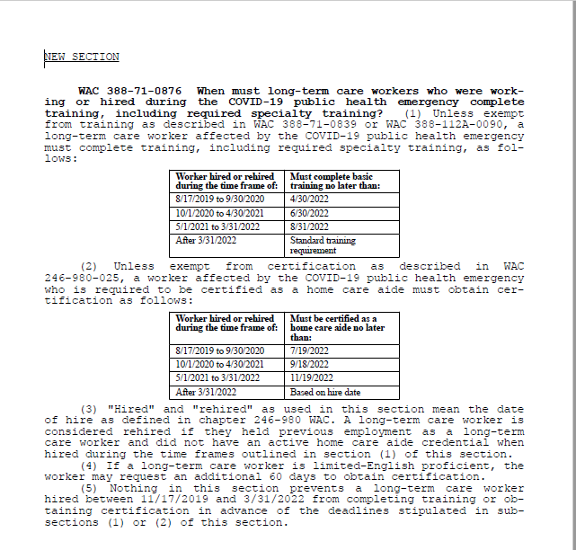

Slide 9
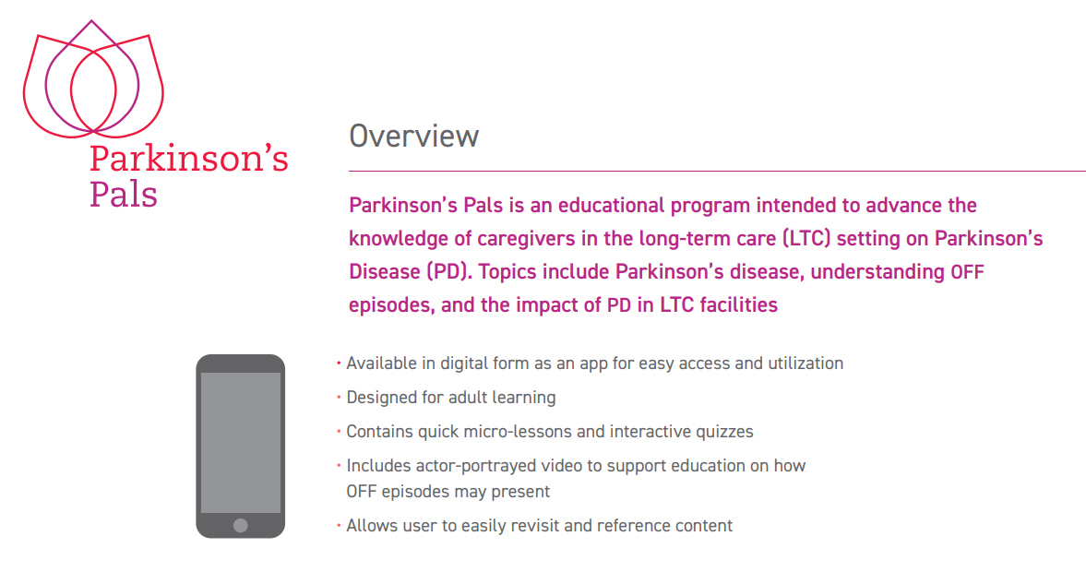
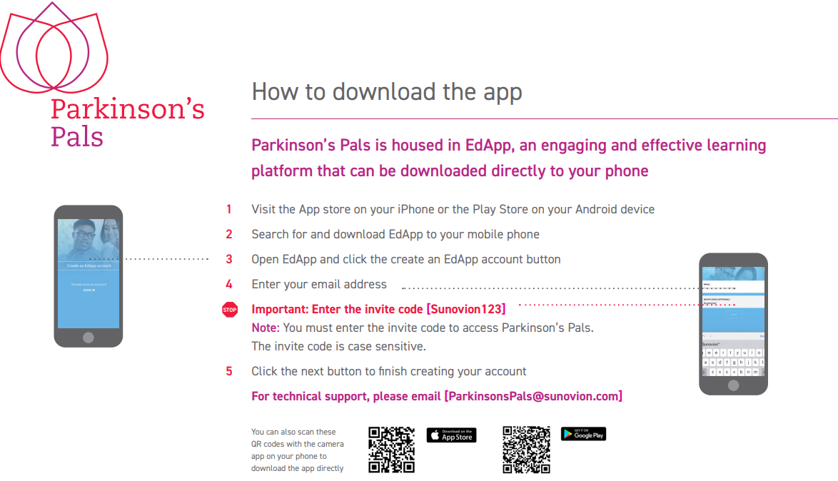
Parkinson’s Pal App

Slide 11
HB1124
Reduce insulin from 4 to ? (2 or nursing judgement) will discuss at next Commission Meeting in January
Broaden glucose monitoring
Nursing Commission Meeting January 14,2022

Slide 12

2022 Meeting Dates
New Times
February 16th 10:00 AM
April 20th 1:00 PM
June 15th 10:00 AM
August 17th 10:00 AM
October 19th 1:00 PM
December 14th 10:00 AM

Slide 13
Thank you for attending
Meeting notes will be posted NEXT week to:
https://www.dshs.wa.gov/altsa/residential-care-services/nurse-delegation-program
Please email:
nursedelegation@dshs.wa.gov for delegation questions
or
nursingcontracts@dshs.wa.gov for contract questions
DDA questions: doris.barret@dshs.wa.gov

