Slide 1
Business Analysis and Applications Unit (BAAU)
Annette Curry
Residential Care Services (RCS)
Business Analysis and Applications Unit Manager

Slide 2
Welcome
Thank you for your interest in becoming an Adult Family Home provider.
All requirements in Washington Administrative Code 388-76-10057 must be met prior to an application being submitted to the Department. Applications submitted without the required items listed in this WAC will not be accepted.
We have outlined frequent errors with both the online application and supporting documents that prevent applications from moving forward.

Slide 3
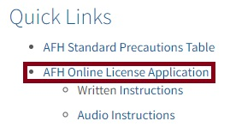
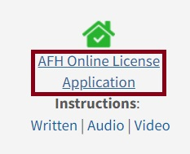
Welcome
BAAU requires all Adult Family Home applications – Initial, Change of Ownership (CHOW), and Relocations be submitted using the AFH Online License Application.
Steps to Login to the Web Application:
Go to the HCLA website at https://www.dshs.wa.gov/altsa/residential-care-services/information-adult-family-home-providers.
Click on the AFH Online License Application under either Quick Links or the house icon.

Slide 4
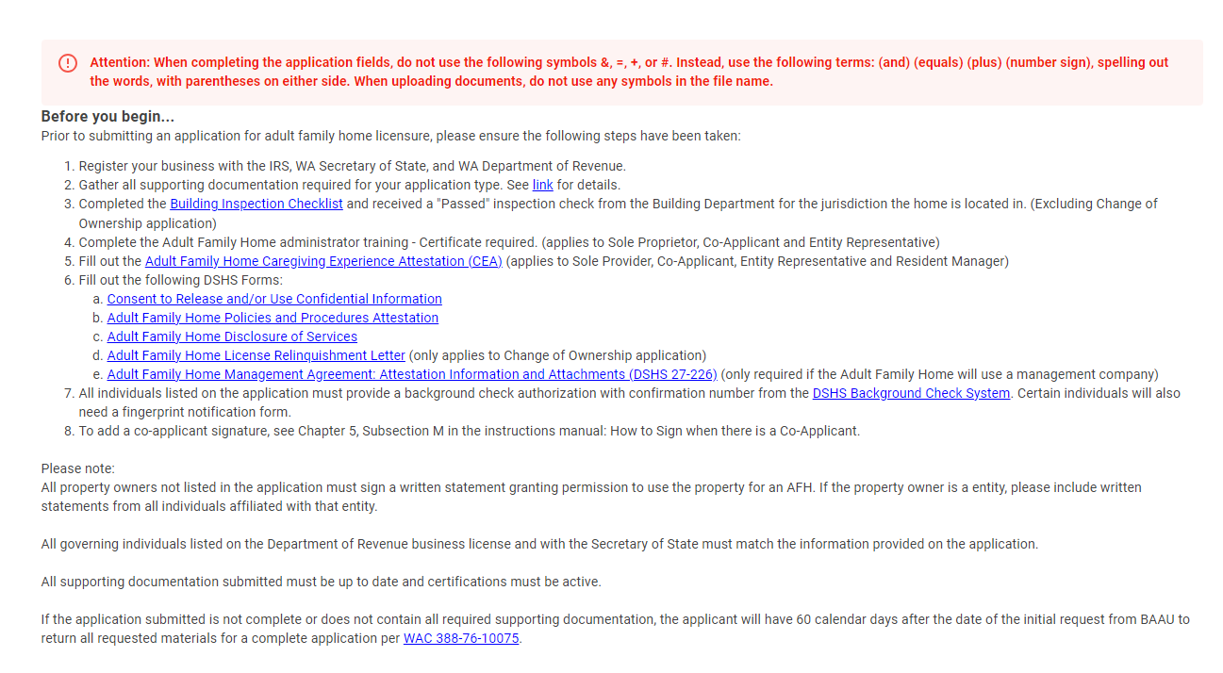
Before you begin…
When you have logged in to create a new application or edit an existing application you can select and save any of the required forms listed on the Before you begin page:

Slide 5
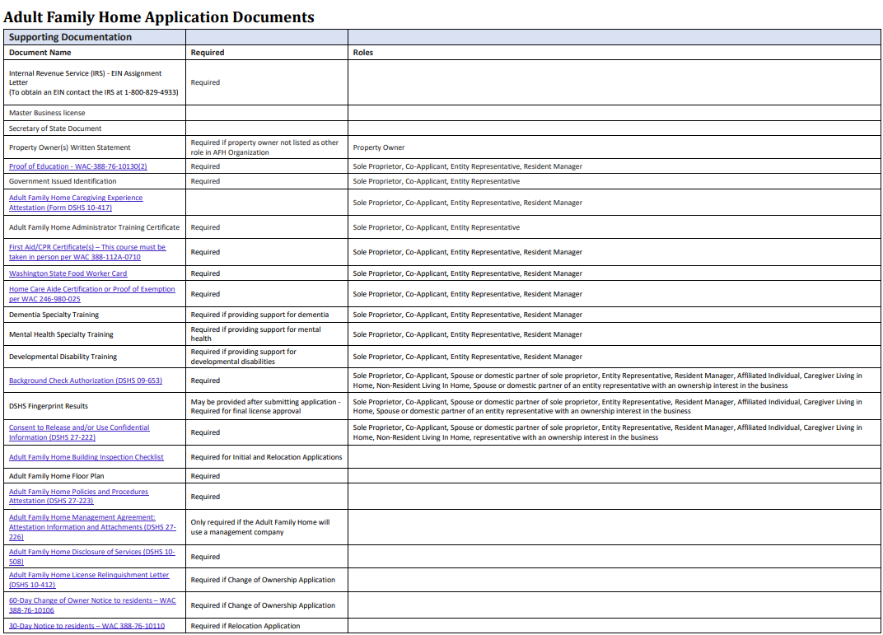
Adult Family Home Application Documents
A list of document requirements can be found in the Adult Family Home License Web Application Manual.
The manual can be accessed by clicking on the Instructions link in the side menu.
Listen to an audio version of the AFH Online License Application Audio Instructions.

Slide 6
Most Frequent Mistakes on AFH Applications
Individuals and Roles
Entity Representative - An entity representative can only be designated to one entity provider, per Washington Administrative Code 388-76-10090(2)(f).
Resident Manager Information - A resident manager can be designated to manage only one adult family home at a given time, per Washington Administrative Code 388-76-10036(3).

Slide 7
Most Frequent Mistakes on AFH Applications
Individuals and Roles
Entity Representative’s spouse or domestic partner
The spouse or domestic partner of an entity representative must be included on the AFH application. The department will conduct a Washington State background check and a national fingerprint background check on the spouse or domestic partner in accordance with Washington Administrative Code 388-76-10115 and Washington Administrative Code 388-76-10161. BAAU will conduct a credit check on the spouse of an entity representative when the entity representative has an ownership interest in the business in accordance with Washington Administrative Code 388-76-10115.
If this applies to the entity representative, add their spouse or domestic partner with the role of Spouse or Domestic Partner under Individuals and Roles in the application.

Slide 8
Most Frequent Mistakes on AFH Applications
Additional People in the AFH – Enter individuals living in the home with no role as a Non-Resident Living In Home, if they are at least 11 years old. They must submit:
A signed and dated Consent to Release and/or Use Confidential Information form.
A completed Background Authorization form with online confirmation code.

Slide 9
Most Frequent Mistakes on AFH Applications
Property Owner(s)
Entered name(s) must match the County Assessor’s website.
If the property is owned by a corporation, enter the business name under the Property Owner Entity Name.
If the property owner(s) are individuals, each individual must be entered separately.
Select either Yes or No regarding each property owner having an active interest in the operation of the AFH. This is in accordance with Washington Administrative Code 388-76-10095(2).

Slide 10
Most Frequent Mistakes on AFH Applications
Property Owner(s) Written Statement
Provide a signed statement from all property owner(s) stating permission to use the property as an Adult Family Home.
Property owners with an active interest in the home must specify in the written statement what their active interest will be, per Washington Administrative Code 388-76-10095(2).
Property Owner(s) and Non-Resident Living In Home – When adding a property owner who resides at the facility location:
First, add their role as a Non-Resident Living In Home.
Next, add their role as a Property Owner.

Slide 11
Most Frequent Mistakes on AFH Applications
Additional Adult Family Homes – The department will only accept and process an application for an additional license in accordance with:
License requirements – Multiple adult family homes – Additional homes
Washington Administrative Code 388-76-10037
Multiple facility operators — Requirements — Licensure of additional homes
Revised Code of Washington 70.128.065

Slide 12
Supporting Documents
Legal Entity Documentation – Department of Revenue and Secretary of State business filings must:
Be open and active.
List all governors.
Match the Legal Entity section of the application.

Slide 13
Supporting Documents
Background Check Authorization Form (DSHS 09-653)
Submit a current Background Authorization form with online confirmation code for the: Sole Proprietor, Co-Applicant, Spouse or domestic partner of sole proprietor, Entity Representative, Resident Manager, Affiliated Individual, Caregiver Living in Home, Non-Resident Living In Home, Spouse or domestic partner of an entity representative with an ownership interest in the business.
Previously submitted background forms, handwritten forms, and expired forms will not be accepted.

Slide 14
Supporting Documents
DSHS Fingerprint Results
If required, you may submit a previous “copy of a national fingerprint background check result letter and any additional information from the department's background check central unit from an individual who previously completed a national fingerprint background check through the background check central unit, provided the national fingerprint background check was completed after January 7, 2012,” in accordance with Washington Administrative Code 388-76-101632(3).

Slide 15
Supporting Documents
AFH Building Inspection Checklist
Initial and relocation applications require a completed and passed Adult Family Home (AFH) Local Building Inspection Checklist.

Slide 16
Supporting Documents
Adult Family Home Management Agreement: Attestation Information and Attachments
If you DO NOT have a management agreement this form is not required.
This form is only required if the Adult Family Home has an agreement with another individual or entity regarding the provision of certain services on behalf of the adult family home.
If you have a management agreement provide the following documents:
  Copy of written management agreement.
  Copy of notice to residents / representatives of management agreement.
  Organizational chart which shows the relationship between the adult family home, manager, and all related entities, including manager staff.

Slide 17
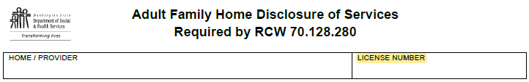
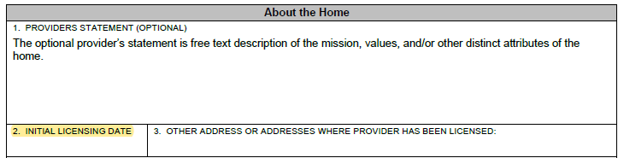
Supporting Documents
Disclosure of Services Form (DSHS 10-508)
Leave the License Number at the top of the form blank.
Leave the Initial Licensing Date field (#2) at the bottom of the form blank in the About the Home section.

Slide 18
Supporting Documents
Adult Family Home Caregiving Experience Attestation (Form DSHS 10-417)
All sections and questions must be completed for the form to be accepted.
The Attestor listed in Section 2 must have the form notarized.
First Aid & CPR Certificate
“Training must include hands-on skill development” led by an instructor, per Washington Administrative Code 388-112A-0710.

Slide 19
Delinquent Debt
In making a determination of whether to grant an adult family home license, the department must consider credit information for applicants and each person or entity affiliated with the applicant, per Washington Administrative Code 388-76-10115. The department does not accept delinquent debt not related to medical debt. Applicants with delinquent debt not related to medical debt will need to provide proof the delinquent accounts have been brought current, or they will need to withdraw their application. Payment arrangements are not accepted. If related to medical debt, provide a brief statement if you are making payments toward the delinquent medical account(s) and provide a copy of your established repayment plan. BAAU accesses credit reports for applicants through Experian. You may contact Experian at (800) 520-1221 if you have any questions related to your credit report.

Slide 20
Tips and Tricks
All certificates and licenses must be valid.
Submitted screenshots or photos captured on a cell phone or tablet may contain only one image per page.
During the application process, BAAU communicates with applicants using the email address listed in the application. Make sure you check your spam or junk folder to avoid missing important messages.
BAAU only communicates directly with the applicant and not a third party. No action will be taken on emails received from a third party.
After making the requested correction(s) to your application, ensure your application is resubmitted for processing.
Verify that all individual names are spelled correctly and match all supporting documents.

Slide 21

Working with the Applicant
Applications are assigned and processed in the order they are received.
Once assigned, the application and supporting documents are reviewed for accuracy and completeness.
After the initial review, an incomplete letter is emailed to the applicant at the email address listed in the application.
Additionally, when application corrections are required, the application is returned through the AFH Online License Application.
BAAU Application Processing Timeline

Slide 22
Cancelled
Application — Cancelled
The department will cancel an application if the applicant:
Does not meet Washington Administrative Code 388-76-10037 and/or Washington Administrative Code 388-76-10032 requirement.
If the current home is closed for any reason during the application process.
If the current licensee/provider no longer agrees to relinquish their AFH license.
Submits incorrect application type (CHOW, Initial, or Relocation).
If the application fee is declined.
When change involves altering legal organization structure of another currently licensed adult family home.

Slide 23
Void and Withdraw
Application — Becomes void
“The department must consider the application void when the applicant does not return information to the department within sixty calendar days of the department’s first request for additional information for an incomplete application,” per Washington Administrative Code 388-76-10075(1). Your application fee will be fully refunded.
Application — Withdraw
Anytime during the application process you may request to withdraw your application. Your application fee will be fully refunded.

Slide 24
Regulations – Resources
Adult Family Home Minimum Licensing Requirements
  Washington Administrative Code Chapter 388-76
  Adult Family Homes
  Revised Code of Washington Chapter 70.128
  Washington State Department of Social and Health Services
  Aging and Long-Term Support Administration (ALTSA)
  Long-Term Care Professionals & Providers
  Residential Care Services (RCS)

Slide 25
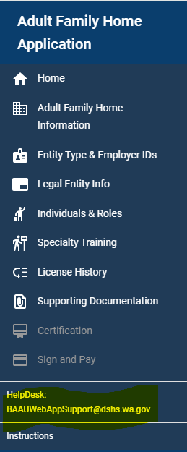
Technical Assistance
For technical questions regarding accessibility or errors when logging into and using the AFH Online License Application please email:
BAAUWebAppSupport@dshs.wa.gov
Include the proposed facility name and address, the Web Application ID, and a description of the problem.
Do not include application supporting documents.

Slide 26
Thank you!
BAAU@dshs.wa.gov

