Slide 1
OBRA NURSE AIDE REGISTRY
COMPLETING AND SUBMITTING A
NURSING ASSISTANT REGISTRY INQUIRY FORM
DSHS 16-193 (REV. 01/2023)

Slide 2
AT THE END OF THIS PRESENTATION, YOU WILL BE ABLE TO
Understand the purpose of the OBRA Nurse Aid Registry
Accurately complete and submit a Nursing Assistant Registry Inquiry Form for each type of OBRA Inquiry
When needed, accurately resubmit forms with further information.

Slide 3
OBRA Nurse Aide Registry
Open weekdays from 8:00 a.m. to 5:00 p.m.
Closed Saturdays and Sundays
Closed State Holidays*
E-Mail: OBRARegistry@dshs.wa.gov
Message Phone: (360) 725-2597
* Inquiries received after 5:00 p.m. on the business day before a holiday will be processed beginning the business day after the holiday. Normal procedures for effective dates still apply.

Slide 4
What is the OBRA Nurse Aide Registry?

Slide 5
The OBRA Nurse Aide Registry ensures NACs working in nursing homes do not go longer than 24 months without at least one shift of compensated, NAC nursing-related duties.
ESTABLISHED BY FEDERAL REGULATION 42 CFR § 483.12
“FREEDOM FROM ABUSE, NEGLECT, AND EXPLOITATION”
at least one shift
every 24 months
for compensation
money, transportation costs (gas, bus fare, etc.), meals, lodging, etc.
providing qualifying NAC nursing/nursing related services
Can be in hospital, home health, adult family homes, assisted living, private care, etc.:
Personal hygiene (bathing, dressing, grooming, oral care)
Mobility (transfer and ambulation)
Continence management
Feeding assistance

Slide 6
What the OBRA Nurse Aide Registry IS NOT

Slide 7
The OBRA Registry is NOT involved in the licensing, credentialing, or testing of NACs.
The OBRA Registry is NOT part of the Department of Health or their licensing/credentialing function.
The status of an NAC on the OBRA Registry is NOT influenced by the status of their license/credential at the Department of Health, and vice-versa.

Slide 8
THE NURSING ASSISTANT REGISTRY INQUIRY FORM (Inquiry Form)
Allow at least two business days for a response to your submission.
It is against federal regulations for an NAC to be hired as an NAC without an inquiry being submitted and verification being received as active on the OBRA Registry.
An employee cannot begin working for a facility until the date verified by the OBRA Registry. There is NO provisional employment allowed in nursing facilities/homes.

Slide 9
THE FACILITY MUST SUBMIT AN INQUIRY FORM FOR
New Employee
Employee Renewal
Employee Termination

Slide 10
Inquiry Form – NEW EMPLOYEE
WHAT IS A NEW EMPLOYEE?
Not currently an NAC at your facility
A rehire
An NAR moving into an NAC position
Submit inquiry at least three days BEFORE you hire.
Must have a future start date (cannot be backdated).

Slide 11
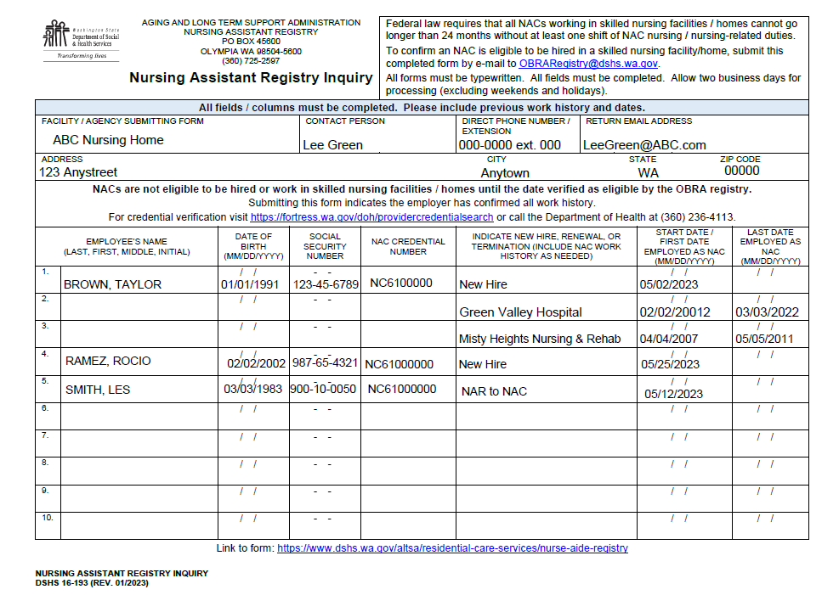
EXAMPLE:
NEW EMPLOYEE
INCLUDING
NAR TO NAC
AT LEAST 3 BUSINESS DAYS BEFORE HIRING OR PLACING AS NAC

Slide 12
Inquiry Form – RENEWAL
WHAT IS A RENEWAL?
Currently employed NACs approaching their expiration date on the OBRA Registry (need to be re-verified every 24 months).
Provide the original start date as NAC at your facility

Slide 13
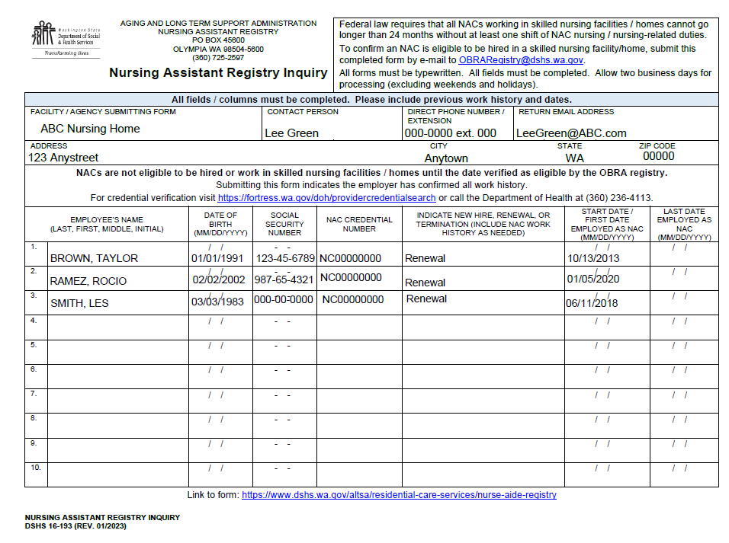
EXAMPLE:
RENEWALS
START DATE IS ORIGINAL FIRST DATE OF HIRE AS AN NAC FOR YOUR FACILITY

Slide 14
Inquiry Form – TERMINATION
WHAT IS A TERMINATION?
A current NAC ending employment with your facility, whether voluntary or enforced.
Provide original date of hire as NAC at your facility
Provide last official day of work at your facility
Submit after last official day of work at your facility

Slide 15
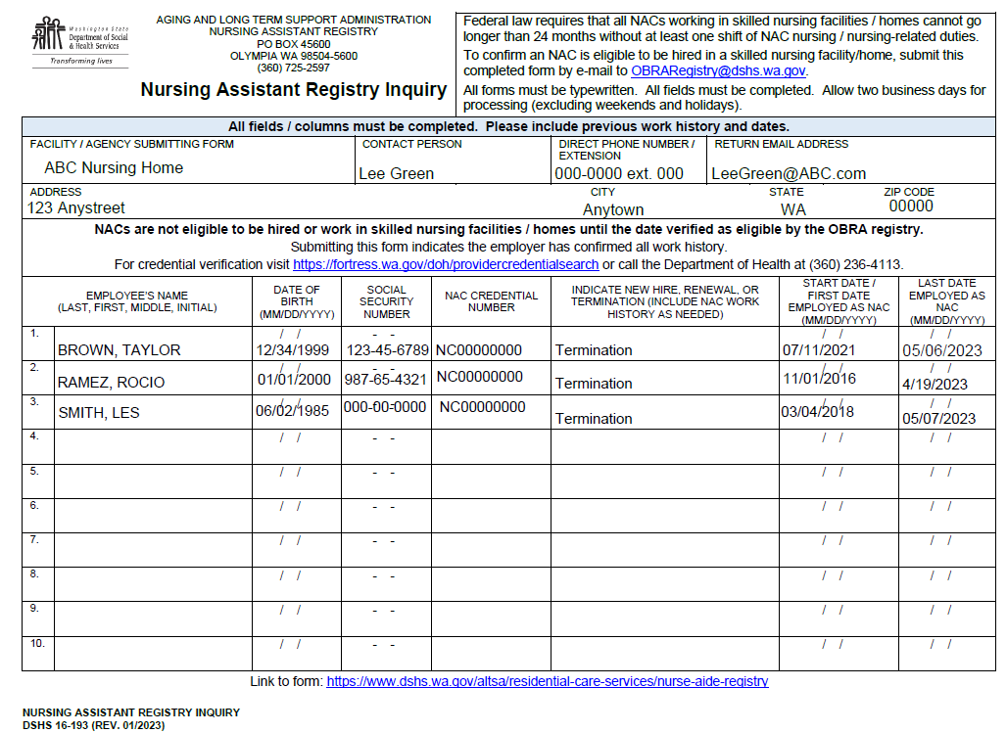
EXAMPLE:
TERMINATIONS
ORIGINAL FIRST DATE OF HIRE AS AN NAC FOR YOUR FACILITY
OFFICIAL END DATE AS AN NAC FOR YOUR FACILITY
(SUBMIT AFTER LAST DATE WORKED)

Slide 16
Inquiry Form – COMBINING NAMES ON FORMS
There is room for up to ten names/lines of information per page.
Use as many lines as needed per person.
You can include more than one person and one type of action on each form.
Do not submit multiple individual forms in a day. They will be returned with a request to combine them.
Combining names helps with processing time and recordkeeping.

Slide 17
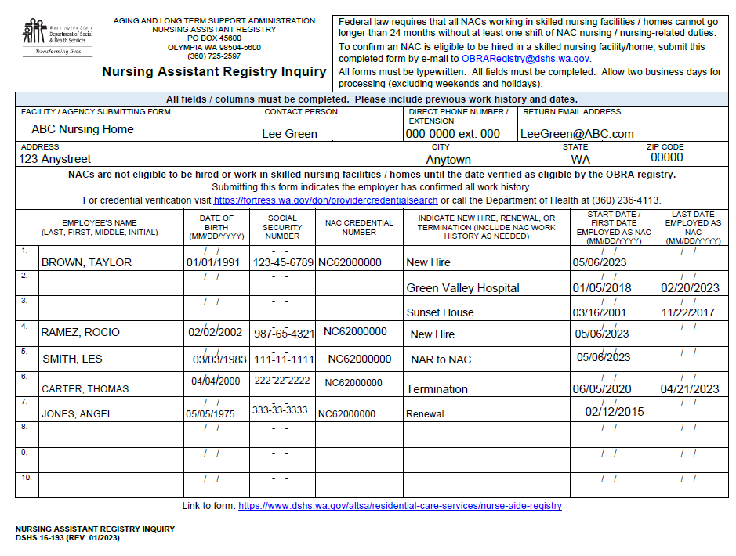
EXAMPLE:
COMBINING MULTIPLE ACTIONS

Slide 18
Employer Information Needed to Complete Form
IF ANY OF THIS INFORMATION IS INCORRECT OR MISSING, THE INQUIRY WILL BE RETURNED AS INCOMPLETE.
Facility/Agency Submitting Form
Organization that is the official employer of the NAC.
Contact Person
Person completing form and can answer questions about submission.
Direct Phone Number/Extension
Contact person’s phone number (direct number is preferred, please provide extension number)
Return E-Mail Address
Only one e-mail per form. The Registry does not store e-mail addresses, the information provided here is literally copied and pasted for the return response.
Address
The physical address of the organization employing NAC.

Slide 19
WHERE TO SUBMIT INQUIRY FORMS
Inquiry forms must be submitted by e-mail to:
OBRARegistry@dshs.wa.gov
For questions, please contact us at:
Message Line: (360) 725-2597 E-Mail: OBRARegistry@dshs.wa.gov

Slide 20
Employee/NAC Information Needed to Complete Form
Full Name (last, first, middle initial)
Birthdate
Social Security Number
NAC Credential Number (not NAR)
Action Requested (New Hire, Renewal, or Termination)
Effective Date of Action
Work History (if needed) - NAC Employer Name(s) and Start/End Dates
IF ANY OF THIS INFORMATION IS INCORRECT OR MISSING, THE INQUIRY WILL BE RETURNED AS INCOMPLETE.

Slide 21
WORK HISTORY
A list of previously held employment performing compensated NAC nursing-related duties.
For facility, include: name of facility, and the start and end dates of employment.
For private client, include: start and end dates of employment, a detailed list of specific nursing-related duties performed, and type of compensation was received. Do not provide name of client (use Client A, Client B, etc.)
NAC nursing/nursing-related skills include assisting patient(s) in hospital, adult family homes, private care, etc. with:
Personal hygiene (bathing, dressing, grooming, oral care)
Mobility (transfer and ambulation)
Continence management
Feeding assistance
Taking and recording vital signs
Only work performing compensated NAC nursing-related duties qualifies as work history.

Slide 22
COMMON REASONS NAC INQUIRIES ARE NOT VERIFIED

Slide 23
INQUIRIES WILL BE RETURNED FOR THE FOLLOWING REASONS:
Form is incomplete or is handwritten
NAC name does not match database (different/misspelled)
Social security number does not match database
Person has expired from the Registry
Work history is needed
Work history is not compensated, NAC nursing-related duties
Effective date of action is not provided
Start date for New Hire is not a future date
(continued)

Slide 24
INQUIRIES WILL BE RETURNED FOR THE FOLLOWING REASONS: (continued)
Inquiry is not for NAC position (the Registry does NOT track NARs)
NAC is not on the OBRA Registry
Person was originally hired without an inquiry being submitted for a pre-hire check
Multiple forms are submitted within a short time period with only one or two names/lines of information per form

Slide 25
THINGS TO REMEMBER
NAC must be verified as active on the OBRA Registry in order to work in your facility
NACs are not eligible to work until date verified by the Registry
Inquiries are processed in the order received (no exceptions)
Inquiries are responded to within two working days (contact the Registry if you do not receive a response in that time)
Contact name you provide should be the person able to answer any questions about the inquiry

Slide 26
RESUBMITTING INQUIRY FORM FOR A RETURNED UNVERIFIED INQUIRY

Slide 27
HOW TO READ THE RESPONSE TO YOUR INQUIRY
AN NAC CANNOT WORK IN YOUR FACILITY UNTIL VERIFIED AS ACTIVE
When you receive an inquiry response, check that the “Registry Status” field says “Active.”
If it is “Active” then your inquiry has been verified and the NAC is eligible to work.
If it is not “Active” (may read “Not on Registry” or “Expired”), please read the NOTE section for that person. This note will explain why the person cannot be verified and what action(s) to take to resolve the issue(s).
If it is “Ineligible” the person cannot be hired and can never work in a nursing facility/home.
Follow the instructions in the NOTE section exactly by correcting or adding information requested and resubmitting an updated inquiry form along with any requested documentation.
(CONTINUED)

Slide 28
HOW TO READ THE RESPONSE TO YOUR INQUIRY
(CONTINUED)
The original action requested remains on the inquiry form. (All information regarding a person’s inquiry should be together on one form.)
Any documentation requested in the response must be included with the resubmitted inquiry form.
The facility is responsible for obtaining and providing the employee’s information. Please do not instruct an employee or potential employee to contact the Registry.
A NAC CANNOT WORK IN YOUR FACILITY UNTIL VERIFIED AS ACTIVE

Slide 29
IF YOU HAVE ANY QUESTIONS,
PLEASE DON’T HESITATE TO CONTACT US
Message Line: (360) 725-2597 E-Mail: OBRARegistry@dshs.wa.gov

