Slide 1
Community Residential Services Training (CRST)

Slide 2
You Should Know…
The estimated time to complete this course is 2 hours or less
The facilitation of this course may be modified to be completed as two individual sessions plus a take away assignment
This course is designed as a facilitated conversation and participation is vital to this training process.

Slide 3
DDA Mission
Transforming lives by providing support and fostering partnerships that empower people to live the lives they want.

Slide 4
Add your agency’s Mission Here…

Slide 5
Purpose
This course is designed For All Direct Support Professionals and we will:
Discuss what Unconscious Bias is
Recognize Unconscious Bias within our interactions
Learn how Unconscious Bias impacts the individuals we support
Give us tools to confront and change unconscious bias (T.I.D.E)

Slide 6
Unconscious Bias
Unconscious
“not aware of something”
“not intended or planned : not consciously done”
Bias
“an inclination of temperament or outlook; especially: a personal and sometimes unreasoned judgment: prejudice”
Notes:
Defined by Merriam-Webster
What is unconscious bias?
How does unconscious bias occur?
What unconscious biases might the individuals that we support experience on a day-to-day basis?
Use this discussion time to really identify biases that can occur around the culture of ability/disability
Once this foundation has been set we will build on the understanding that individuals can experience many other social identities that might further impact their experiences and/or service delivery.
It is important to note that we all have biases, even those of us that are consciously working to overcome biases.

Slide 9
DDA
Guiding Values
Inclusion
Status and Contribution
Relationships
Power and Choice
Health and Safety
Competence

Slide 10
Social Identities are…
Cultural group(s) to which individuals are defined as belonging to
May be a result of personal identification
May be imposed by the way others see , believe and/or react
Notes:
On the next slide we are going to identify other common social identities that individuals may experience unconscious bias about.

Slide 11
ADDRESSING
Age
Development
Disability
Religion
Ethnicity
Social Class
Sexual Orientation
Indigenous Heritage
National Origin
Gender
Notes:
Social Identities can be related to:
Age
Development
Disability
Religion
Ethnicity
Social Class
Sexual Orientation
Indigenous Heritage
National Origin
Gender
And are often identified by ending in “Ism”
Ask for examples of each “ism”

Slide 12
Agents and Targets
Are the statuses within each social identity
Assignment of status within a cultural identity may vary by situation
Individuals may not identify with the same status for every cultural identity
Notes:
Who might be considered an Agent?
Who might be considered a Target?
Does this change based on societal/cultural/environmental situations?

Slide 13
Agents Vs. Targets
Agent
Target
Experiences benefits and/or privileges
Has increased availability of resources
Benefits from inequalities
Experiences oppression and/or limitations
Has reduced availability of resources

Slide 14
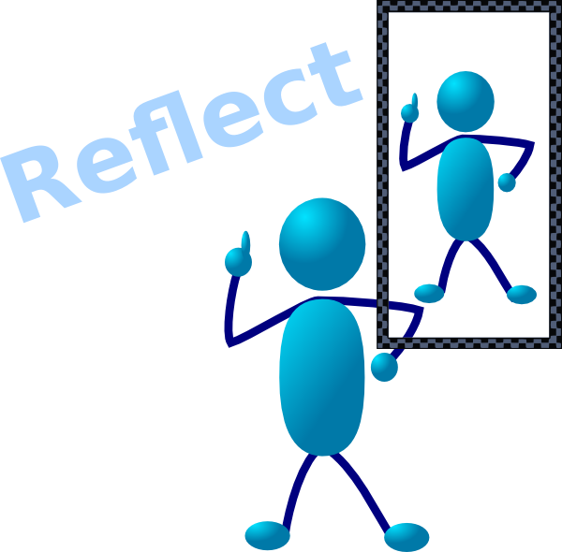
Time to look at ourselves…
Think about Unconscious Bias
Think about a situation where you once had an unconscious bias
Be prepared to discuss
What was the bias?
How did it impact those around you?
How did you change that bias?

Slide 15
Notes:
THINK
Reflect on interactions we’ve had with others. Were they respectful? Consider comments that don’t reflect our beliefs or values.
Card Exercise:
Think about the things you say. What are the actual meanings of phrases that have been handed down through generations such as “that store clerk just tried to gyp me”? This saying and others like it are deeply rooted in bias. It’s good to consider the effect our words and actions have on others.
Most of us would never intentionally say or do things overtly biased or prejudiced, yet we all may say or do things stemming from unconscious bias. Sometimes, we simply don’t give much thought to them. Labeling, generalizing about people or behaviors, asking insinuating questions about attire and gestures, or mocking speech patterns are examples of things we may say and do, just because we always have.
Ask participants to provide examples of unintentional things that may not reflect our values.

Slide 16
Notes:
INQUIRE: Ask respectful questions to avoid making assumptions. Listen to gain information, insight, and understanding.
Card Exercise:
Ask respectful questions to avoid making assumptions. Listen to gain information, insight and understanding.
Inquiry is respectful questioning from a place of curiosity and a desire to connect with another person and actively listening.
Respectful curiosity looks at differences through the lenses of humility and admiration. How we ask questions about someone’s personal identity can make all the difference.
Asking “So, what kind of Asian are you?” is different than “May I ask you about your national origin?” Asking if we can ask expresses openness and safety for the other person to decide what they wish to share about their identity and experience.
Listen closely to the answer, rather than planning your response. When telling their story, people may often reveal clues about whether they have experienced bias. The best response may be: “I appreciate you sharing.”
Being present and listening without refocusing on your response is so important. It reinforces your desire to listen, learn and connect.
Ask participants to provide examples of respectful questioning.

Slide 17
Notes:
DO: Do something to acknowledge bias and shift perceptions. Refrain from laughter or silence. Reduce the impact of bias jokes or comments.
Card Exercise:
Do something to acknowledge bias and shift perceptions. Refrain from laughter or silence. Reduce the impact of bias jokes or comments.
It’s sometimes difficult to know how to react when we hear comments or see actions that slight, ridicule or mock people.
Acts of bias are so common that we may become immune to their effect or wonder if we are “reading too much into it.” We have a responsibility to DO something to make change. But what?
We can speak up. We can work to educate ourselves and others about how what we say, even unintentionally, can be hurtful and reinforce stereotypes. Don’t laugh or “just to go along with the joke.”
It can be awkward to speak up for others and even more disconcerting to stand up for ourselves. We may feel as if we are being too sensitive or that nothing was really meant by an off-hand comment. The reality is that acts and words of unconscious bias have lasting detrimental effect, regardless of intent. We can change that outcome.
Ask participants HOW they would intervene with situations where unconscious bias in happening. How could they do this while out in the community with those they support?

Slide 18
Notes:
EMPOWER: Model and motivate courageous self-appraisal. Offer opportunities for conversation and education. Thank those who have the courage to think, inquire and do. Also think about how we would empower individuals with Developmental disabilities to speak up about bias that is hurting them and become their own self-advocates.
Card Exercise:
Model and motivate courageous self-appraisal. Offer opportunities for conversation and education. Thank those who have the courage to think, inquire and do.
Calling out unconscious bias can be scary. Yet we all must have the courage to interrupt the buried beliefs of others and ourselves.
We can raise awareness about and shift unconscious bias. By thanking others when they speak up, we validate their actions. We reinforce their courage and renew their resolve.
The simple act of pointing out a belief rooted in unconscious bias takes bravery. If even one other person chimes in to challenge biased thinking, others are encouraged to be brave as well. We can support each other and create change.
We begin Turning the TIDE on unconscious bias when we do something and empower others through validation, praise and thanks when they have the courage to stop unconscious bias and model support.
Ask participants to provide examples of some of the ways that they can practice self-reflection and how they can empower individuals they support to speak up about biases experience from others (including us).

Slide 19
Notes:
Now it’s time for application:
Ask participants to share the scenarios that they identified for their take away assignment and discuss:
What was the bias?
How did it impact our work?
What could be done differently?

Slide 20
Additional Resources
Put links to your policies or where they can find an employee handbook here.

Slide 21
Your Turn!! Please Type in your questions to me!
Sarah Blanchette
Residential Services Training
Program Manager
360-407-1540
BlancSR@dshs.wa.gov

