Slide 1
Tribal/State Partner Behavioral Health Prevention, Education, and Awareness, Campaigns
GTLSSC Presentation

Slide 2
Overview of Behavioral Health Prevention, Education, and Awareness Workgroup

Slide 3
Purpose and Overview
Formed as a priority of GTLSSC
Addressing Tribal requests during Tribal Opioid Summits and Centennial Accord to support youth education materials
Address the opioid/fentanyl crisis
Met every two weeks in preparation of GTLSSC
Tribal/State Co-Chairs
  Vice Chair de los Angeles, Snoqualmie Tribe
  Lucilla Mendoza, HCA & Candice Wilson, DOH

Slide 4
Existing Behavioral Health Prevention, Education, and Awareness Work

Slide 5

Notes:
Overview of existing campaign and materials and acknowledgement of what is currently available.
Tribal Opioid/Fentynal Campaigns For Our Lives
Tribal Suicide Prevention Campaigns - Native and Strong Lifeline
Native and Strong Lifeline 988 option 4 line
Native Resources Hub
NPAIHB Tribal Opioid Response and Suicide Prevention Materials
We Are Native

Slide 6
Tribal Behavioral Health Behavioral Prevention, Education, and Awareness Campaign History
2017
“Tribal Opioid Solutions” Campaign materials were developed and launched in partnership with Office of Indian Policy/Indian Policy Advisory Council and Tribal representatives.
2019–2021
HCA (in close collaboration with Native partners across the state and contractor DH) continued the campaign focus on opioid prevention, treatment, and recovery through the sharing of educational materials.
2021
Suicide Prevention Campaign materials created through Government to Government and informal Tribal workgroup review process.
“Native and Strong” Suicide Prevention Campaign Launched
2022
Fentanyl overdose prevention and naloxone education deemed a priority focus for the campaign.
“For Our Lives” campaign launched folding in existing materials formally (Tribal Opioid Solutions)
2023
Native and Strong Lifeline (988) and Native Resources Hub campaign materials were created and launched.
First Annual Tribal-State Opioid Summit & National Tribal Opioid Summit
2023

Slide 7
Development and Production Process
Partners from Tribes, Native-serving organizations, and workgroups were invited to review of all campaign materials
All campaign assets shaped directly by insights and feedback shared by 30+ Native partners and members of the review group
Presentations on campaign updates at Monthly Tribal Meetings
Presentation on campaign updates and invitation for feedback at monthly AI/AN Opioid Response Workgroup Meetings
Periodic surveys sent to Native partners, and most recently to Tribal Leadership to invite feedback and participation in campaign development
Internal reviews by HCA Office of Tribal Affairs, Communications, DBHR, and most recently DOH Tribal Liaisons
Notes:
Engagement of an informal review group is a critical element of the Tribal Opioid Solutions and For Our Lives campaigns.
Native partners in communities across the state are thought leaders - acknowledging their authentic experiences and deep knowledge in this space through professional or personal experiences
The campaign teams value feedback from partners across the state, given diverse and unique experiences, to ensure materials resonate meaningfully with a broad spectrum of Native audiences in Washington
In addition to the informal review group: Periodic Dear Tribal Leader Letters as new materials are developed

Slide 8
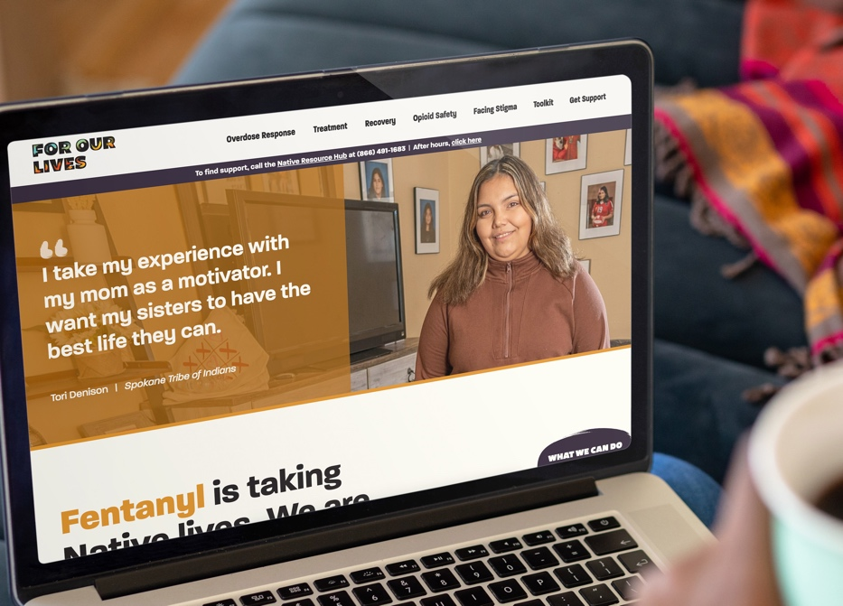

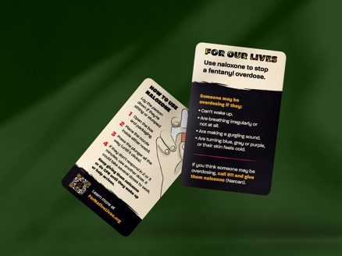
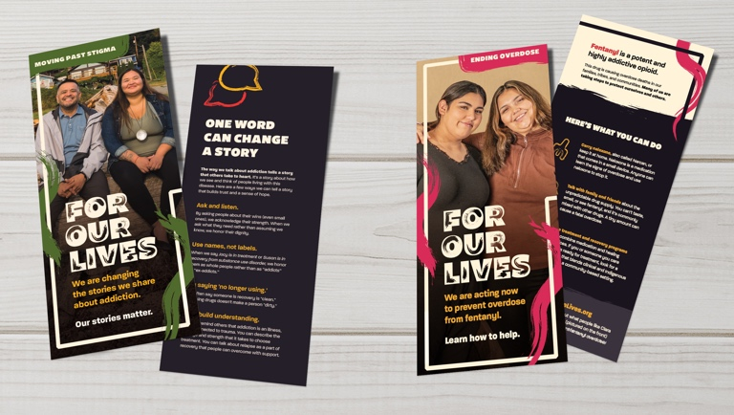
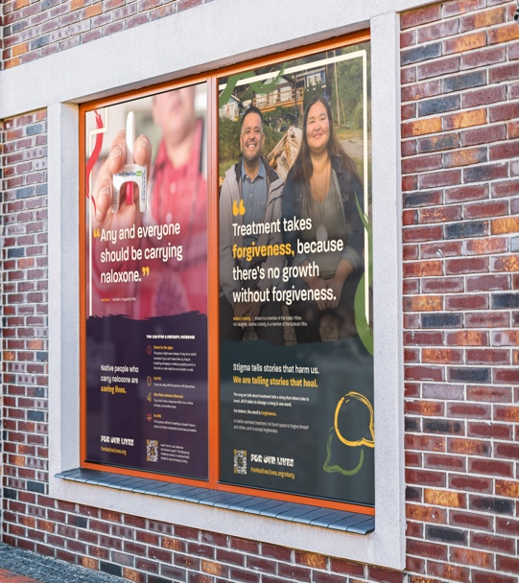
www.ForNativeLives.org
Goals:
Native-centered education
Illicit fentanyl information
Overdose prevention
Naloxone awareness
Treatment and recovery
Destigmatization
Audiences:
Native people (adults), Tribal communities
Notes:
For Our Lives was created in tandem with Tribal members.
Although it is focused on adults, proposed legislation would fund a youth and young adult component.
The materials in this campaign will be distributed to all Tribes and each tribe will receive $30,000 to implement the campaign however they wish.

Slide 9


Slide 10
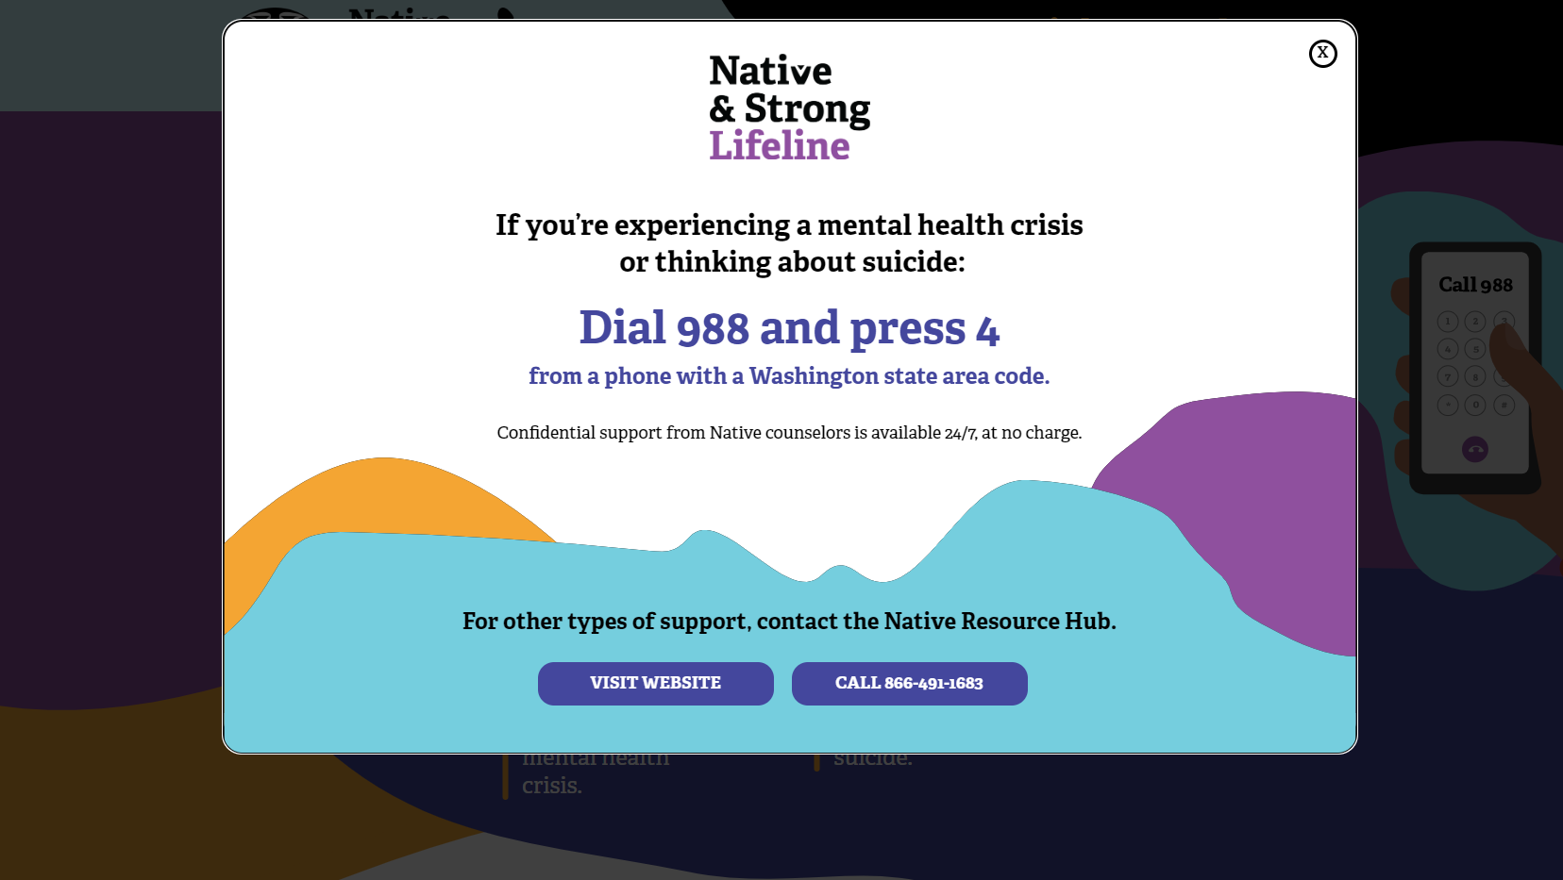

Slide 11
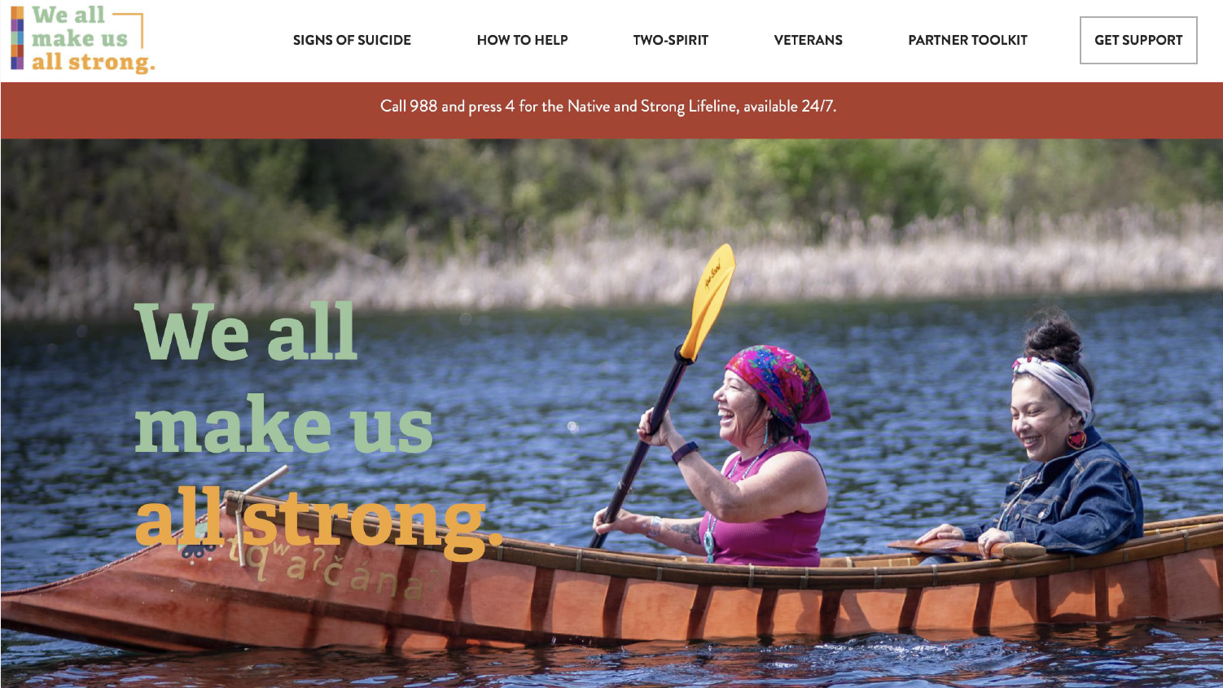

Slide 12
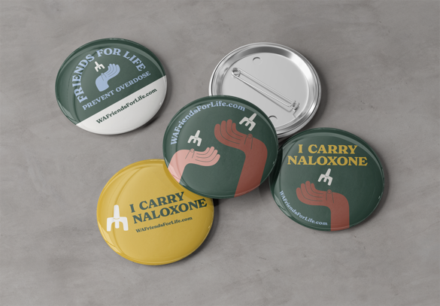
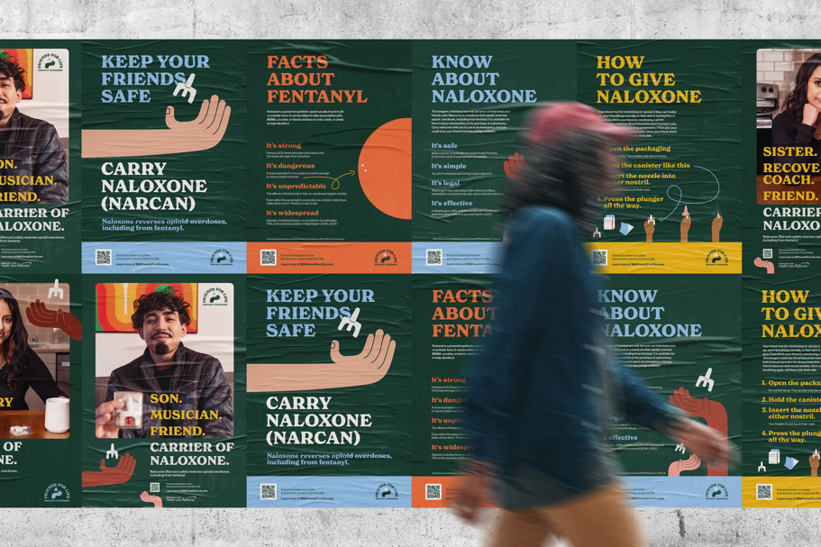


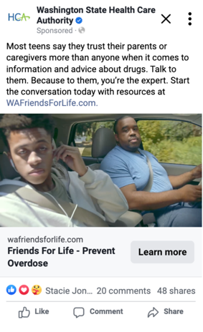
www.WAFriendsForLife.com
Goals:
Illicit fentanyl education
Overdose prevention
Naloxone awareness
Harm reduction
Audiences:
Teens, young adults, parents/caregivers
Notes:
- Launched April 2023
- start and end with the same people – lots of surveys and focus groups in the development of material at every stage
- main tenet of message platform is that everyone deserves a chance to live, full stop
- information on harm reduction and prevention currently, will be expanded in 2024 to include MOUD education
- aims to change cultural norms of sharing medication
- recently won a Silver Anthem Award in the Health category

Slide 13
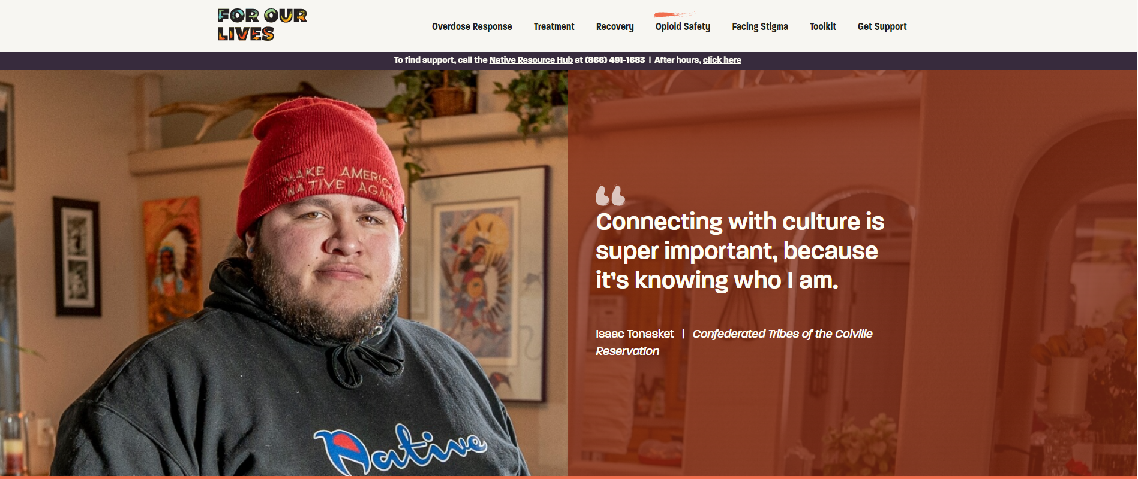
Upcoming Events
Collaboration for Participation
September 20 – County level opioid event hosted by DSHS – Local Planning Agencies (LPA)
Green Hill Pow Wow
July - Tribal Opioid Summit
June 14- 16th - 78th Annual Lummi Stommish Water Festival
UW Suquamish, All My Relations at Skagit Valley Pow Wows
Power Paddle – Puyallup (multiple event)
Northwest Indian College Graduation
May 28 – 30 Tribal Wellness Gathering
Indigenous Advisory Council
Notes:
Discussed ways to ensure existing materials are getting out into communities by working together Lucilla Mendoza
For Our Lives materials and Native and Strong and Strong materials are available and targeted efforts to meet with each Tribe to share resources and get materials to communities is underway.
Create a shared list of Tribal, Native and other large events to share materials is underway with commitment to partner to get materials out at these events.
Identify the costs to ensure all State agencies have access to tabling toolkit for attending events in their structures
Commitment to work on future campaign materials, especially materials for youth.
How do document these collectively? Monitor how many events we get out there and talk to the communities about opioid education materials.
Create a Spreadsheet to document
Each representative report out

Slide 14

Upcoming Events - Tribal Media Venues
Tribal Gatherings & Community Events
First Salmon Ceremonies
CSO/LPA & Career Fairs
Elder luncheons
Northwest Indian College graduation
Canoe Races
Power Paddle Puyallup Canoe Journey for Youth - Tribal landing locations
Pow Wow's
Stick/Slahal Games
Youth Tourneys
Basketball Tourneys
Baseball Tourneys

Slide 15
Future Behavioral Health Prevention, Education, Awareness, Campaign Work

Slide 16
2024-2025 Legislative Education Initiatives
Tribal Opioid Prevention Campaign, 2 million, HCA
Statewide overdose prevention campaign, 2.6 million, DOH
E2SHB 1956-K-12 learning standards and develop classroom materials aligned with DOH prevention and awareness campaign
  $334,000 FY25 & $125,000 FY26 Office of Superintendent of Public Instruction
988 Campaign Funding (1134)

Slide 17
Legislative Session - Upcoming Related Work
STEC schools, “Culturally Appropriate materials”, $900,000, OSPI
SB 2408 Native and Strong Lifeline – Text and Chat, $2 million, DOH
2SHB 2112 – Higher Education Opioid Prevention $412,000, OSPI
  $232,000 UW
  $95,000 EWU
  $22,000 CWU
  $97,000 Evergreen State College
  $112,000 WWU
  $412,000 to State Board for Community and Technical Colleges
Notes:
Our workgroup Is requesting feedback on our work this far. Please share any feedback on our plans thus far. It is important that we hear from Tribal leader and Tribal health staff for direction an priorities

Slide 18
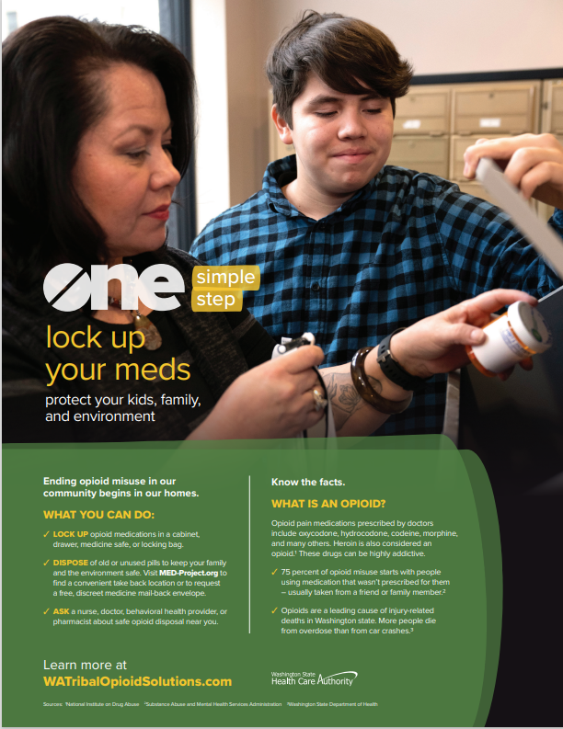
HCA – Tribal Opioid Prevention Campaign
Focus on youth education
Build off of existing campaigns
  For Our Lives
  We Are Native
  Friends For Life
Solidify plan for media vendor
  Existing vendor
  Request for proposals
  Existing vendor with expansion of additonal partnership with Tribally operated vendors across the state.
Ensure youth engagement actvities are robust to focus messaging on youth.
Ensure robust evaluation informed by Tribal leaders and Tribal representatives.
Ensure campaign saturation informed by Tribal leaders and Tribal representatives.
Notes:
HCA received 2 million for opioid prevention campaign
OSPI/DOH received funding for youth education materials
Workgroup decided to focus on youth materials, expanding upon existing campaigns if possible
For Our Lives, We Are Native, or Friend For Life
Workgroup decided to find ways to engage youth extensively in youth campaigns for 2 million HCA dollars
Actvities in STEC schools and Title 9 Schools and other events where youth will be present
Considering options for contractor for the Media campaig

Slide 19
Youth Engagement Activities
Brainstorm 1: River Ridge High School Example, STEC School High School feedback activity
Brainstorm 2: Upcoming Tribal Wellness Gathering - youth track.
Brainstorm 3: Share materials and gather feedback from caregiver and youth in foster care.
Brainstorm 4: Work with Native youth in JR facilities, accessing JR services.
Brainstorm 5: Youth music programs/sharing stories through music

Slide 20
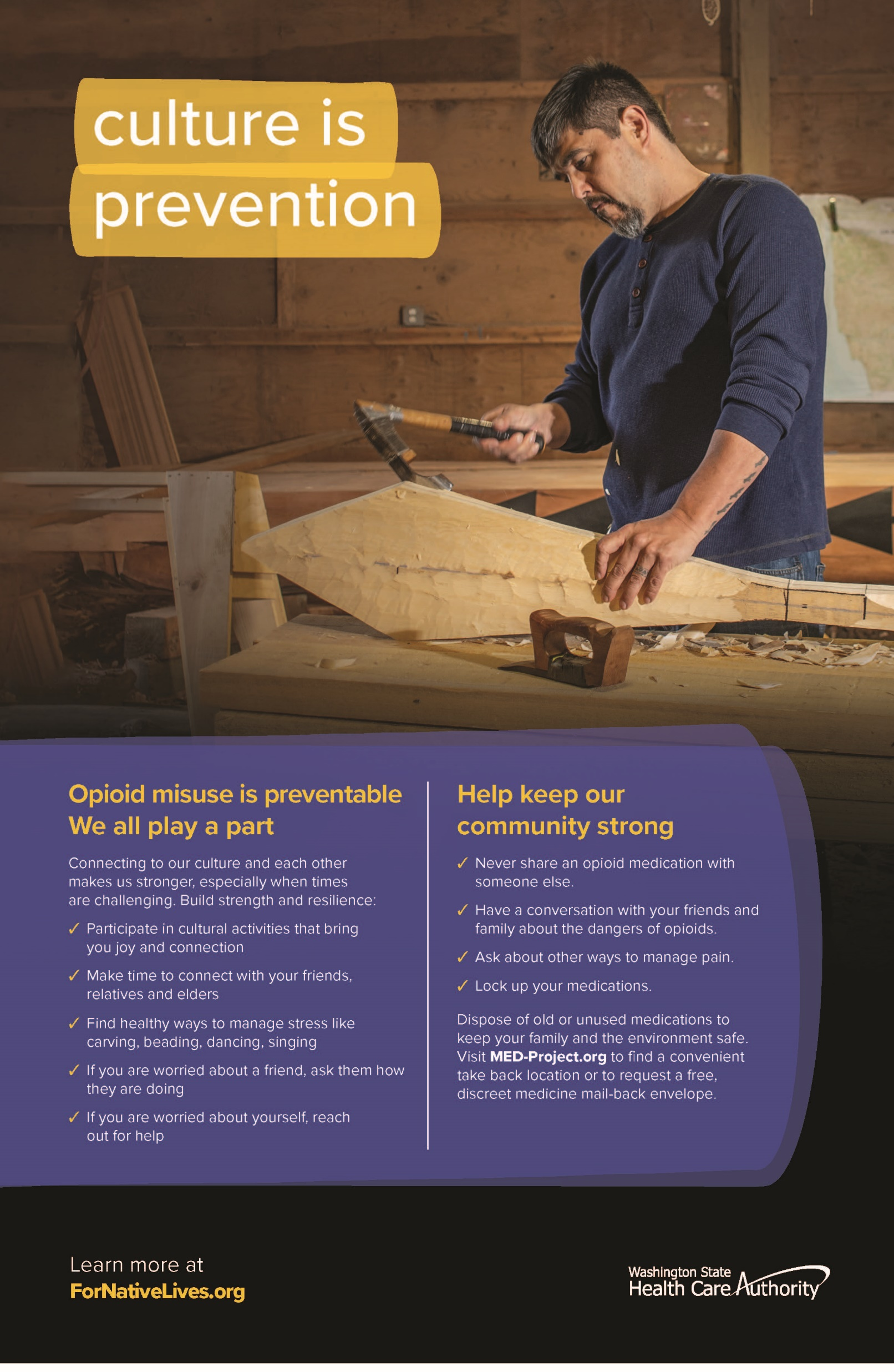
River Ridge High School Event
Native civics classroom learning about opioid legislation
Class chose to focus on opioid crisis due to concerns in their communities
Studied opioid legislation prior to event.
DH “For Our Lives” campaign vendor facilitated event with class requesting feedback.
Positive experience for youth and adults.
Gathered great feedback for youth messaging.
Notes:
Mona/Lucy

Slide 21


OSPI Fentanyl/Opioid Pilot Project
Mona Halcomb, Ed.D., Native American Student Success Program Supervisor
Email: mona.halcomb@k12.wa.us, Phone: 360-725-6000
Henry (Stahobi) Strom he/his, Executive Director, Email: henry.strom@k12.wa.us, Phone: 360 918 3953
Rebecca Purser, Suquamish, MPA, Rebecca.purser@k12.wa.us
Office of Superintendent of Public Instruction, Office of Native Education
2024 Office of Native Education

Slide 22
State-Tribal Education Compact Schools (STECs)
STECs Participation is Voluntary
  Outreach to STECS to express interest
    3 STECS to date
      Reminder email sent out 5.2.24 of 5.8.24 deadline
Grants for One Year Pilot Project
  EGMS credentials established
  Job description development- SUP/I/Cultural
Intent - Fund FTE for Substance Abuse Prevention/Interventionist
Office of Native Education
  Facilitates STECs Grant Award / Implementation
  Convenes STEC Interventionist to Build Capacity
  Identifies Culturally Responsive Curriculum / Implementation
  Data and Reporting Requirements / Timelines
  Prepares August Report
  Prepares End of the Year Report
  Shares Promising Practices with Districts serving AI/AN Youth
2024 Office of Native Education
Notes:
Note: grant award amounts will be dependent upon the number of STEC’s that participate
DOH/HCA to share their future projects
OSPI - Henry Strom & Rebecca Purser

Slide 23
Opioid Education in Schools
DOH overseeing statewide social marketing campaign (will have a youth track and an adult track).
DOH hiring 2 staff, 1 to coordinate the statewide campaign and 1 to work on required education materials.
Materials for schools will complement statewide campaign messaging.
DOH working on identifying additional funds to support this work.
Notes:
3 STEC schools have expressed interest to date. Quarterly connection with STEC schools, then bring to other school districts.
River Ridge school.

Slide 24
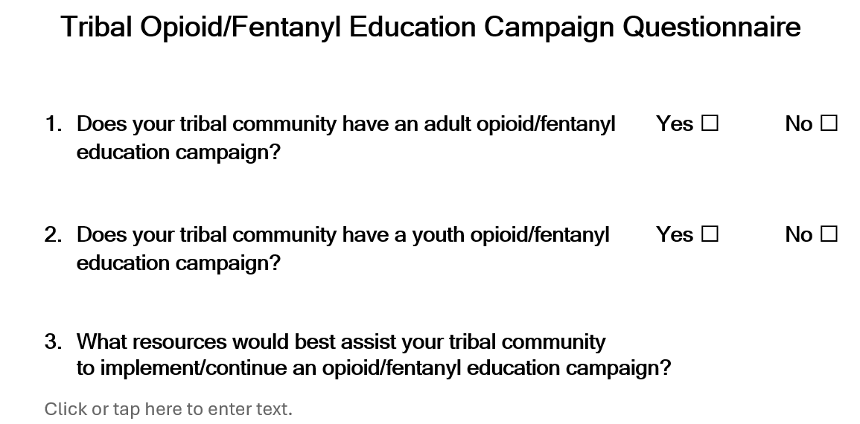
Tribal Behavioral Health Prevention, Education, and Awareness Survey
Drafting questions and sending out to tribal leaders to learn what is happening in tribal communities
Leading to a youth panel to take place ahead of the Centennial Accord
Notes:
Drafting some questions and sending them out to tribal leaders. Hoping for tribes to provide feedback so we can learn more about what is going on in tribal communities. This is leading to a youth panel that will hopefully take place ahead of the Centennial Accord.
Survey to Tribal Leaders - Tim Collins

Slide 25
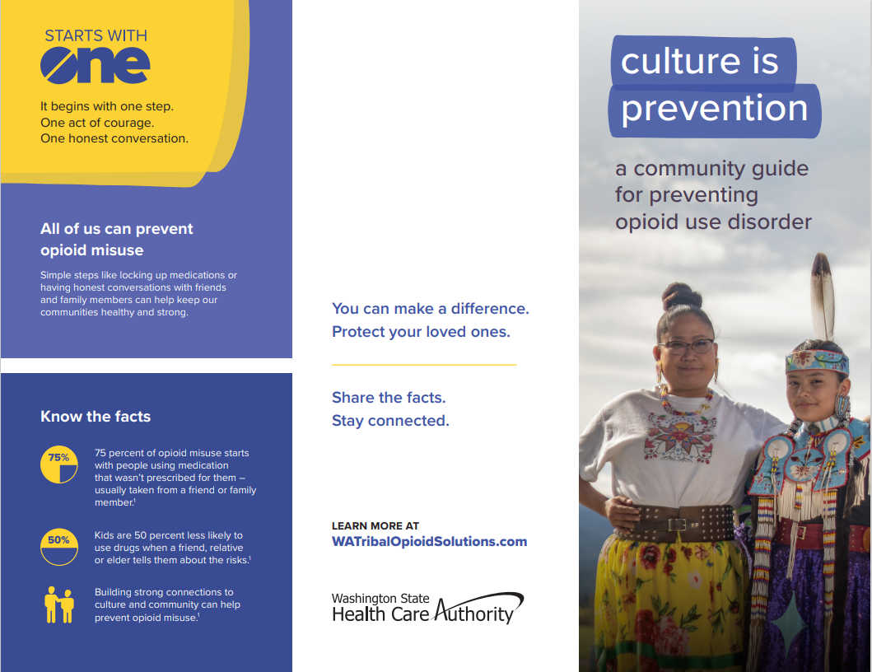
Youth Panel Considerations
Notes:
Youth Panel at Centennial Accord - Tim Collins

Slide 26
Next Steps
Solidify plan for youth prevention, education and awareness campaign
1
Continue Opioid Prevention, Education, and Awareness Campaign Workgroup monthly
2
First Thursday, every month, 1pm – 2:30pm
Review input via email as an option.
Send out and complete Behavioral Health Prevention, Education, and Awareness Survey.
3
Who would like to particpate?
Notes:
Wrap up and Next Steps, Vice-Chair de los Angeles
We would like to continue this workgroup to have continued collaboration and feedback on education materials to address opioid/fentynal and suicide crisis. Please do share if you would like to particpate in the workgroup on by email to provide feedback along the way. As we create new materials or determine processes, it is our goal to gather feedback in multiple ways.
We thank those that have participated this far. It has been a great example of collaboration.

Slide 27
Feedback Requested
Do you think available education campaign resources and funding should be dedicated to standing up a youth campaign?
If so, should a new campaign be created, or should it be built upon the existing campaign?
Other recommendations?

Slide 28
Contacts
Candice Wilson – Quatz’tenaut (Lummi), Executive Director
Office of Tribal Public Health & Relations
Email: candice.wilson@doh.wa.gov, Phone: 564-233-1340
Colleen Cawston, Tribal Relations Director
Department of Correction
Email: colleen.cawston@doc1.wa.gov, Phone: 360-789-1655
Tim Collins, Senior Director
Office of Indian Policy, Office of the Secretary, Washington State Department of Social and Health Services
Email: tim.collins@dshs.wa.gov, Phone: Olympia 360-902-7816
(c) 425-327-5614
Lucilla Mendoza, Tribal BH Administrator
Office of Tribal Affairs, Health Care Authority
Email: lucilla.mendoza@hca.wa.gov, Phone: 360-819-7020
Henry (Stahobi) Strom he/his, Executive Director
Office of Native Education, Office of Superintendent of Public Instruction (OSPI)
Email: henry.strom@k12.wa.us, Phone: 360-918 3953
Mona Halcomb, Ed.D., Native American Student Success Program Supervisor
Office of Superintendent of Public Instruction, Office of Native Education
Email: mona.halcomb@k12.wa.us, Phone: 360-725-6000
Rebecca Purser, Native Educator Cultivation Program Supervisor
Office of Superintendent of Public Instruction, Office of Native Education
Email: rebecca.purser@k12.wa.us, Phone: 564-200-4549

